Slide 1
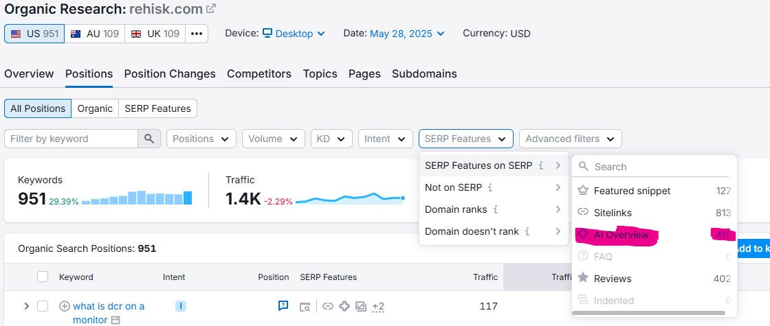
SEO Strategy Report: Adapting to Google’s Latest Algorithm Updates and AI-Powered SGE
Overview
In the era of Google’s AI-powered Search Generative Experience (SGE) and the latest algorithm updates, a traditional keyword-focused SEO approach is no longer sufficient. We must pivot toward deep, helpful content that not only addresses user intent but also aligns seamlessly with how Google’s AI surfaces information. This strategy emphasizes real expertise, semantic optimization, and technical excellence.
Core Concepts of Google’s Latest Algorithm & SGE
Helpful Content System Update (March 2024)
Content must be genuinely helpful, prioritizing value for real users rather than manipulative tactics for search engines.
AI Overviews (SGE)
Google’s SGE leverages generative AI to provide direct answers in search results, highlighting the importance of authoritative and well-structured content.
EEAT Framework
Experience, Expertise, Authoritativeness, and Trustworthiness (EEAT) remain crucial for establishing credibility and ranking power.
Core Web Vitals & Page Experience
A technically sound website with fast-loading, secure, and mobile-friendly design continues to be a ranking factor.

Slide 2
Strategic Action Points
Deep, Expert-Level Content
Craft comprehensive long-form content that thoroughly explores core topics.
Use a layered approach with topic clusters to address every facet of user intent. Incorporate real-world expertise, insights, and unique value propositions.
Long-Form + Short Answers
Long-Form: Provide in-depth, authoritative insights that satisfy the full scope of user queries.
Short Summaries: Include concise, high-value summaries at the beginning of articles or as standalone sections for AI to easily extract and display in search overviews.
Semantic SEO
Optimize beyond keywords using NLP entities, synonyms, and contextual relevance to strengthen topic coverage.
Implement semantic variations to better align with Google’s AI language models.
On-Page SEO Best Practices
Schema Markup: Utilize structured data like FAQ, How-To, and Product schema to enhance SGE visibility.
Author Bios: Highlight authorship and credentials to reinforce EEAT signals.
Internal Linking: Strategically link related articles within topic clusters to strengthen topical authority.
Visual Content: Add short-form videos, original images, and custom graphics. Google increasingly prioritizes rich visual content in AI-generated summaries.
Conclusion
By integrating these advanced content and on-page SEO practices, we will position ourselves at the forefront of the evolving search landscape. Our focus on long-form, short-form, and semantic SEO—combined with an emphasis on visuals and robust EEAT—will ensure our content resonates with both users and Google’s AI-powered search features.

Slide 3
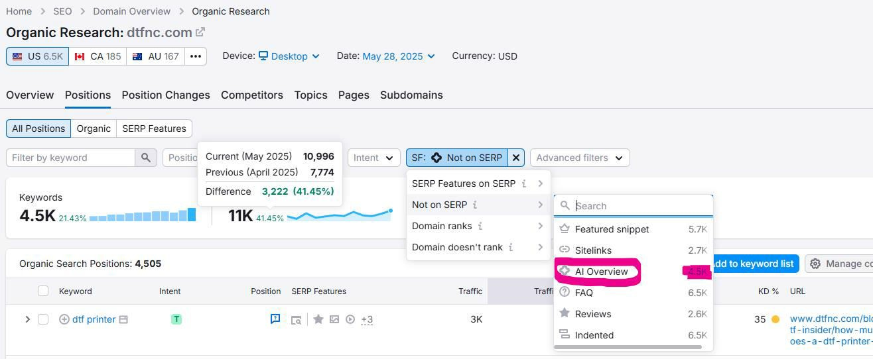
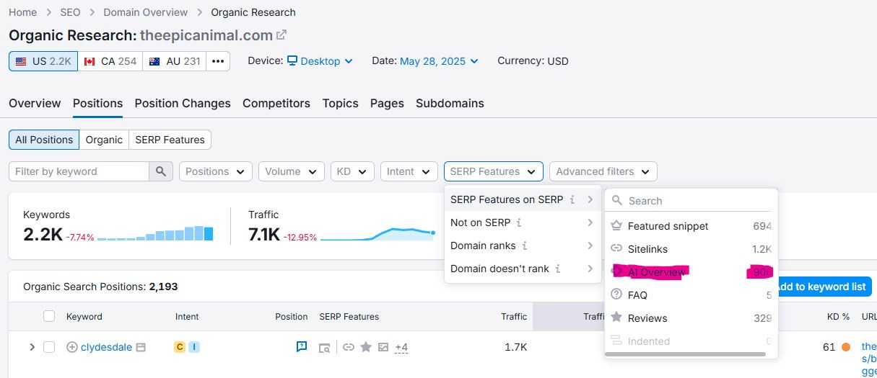
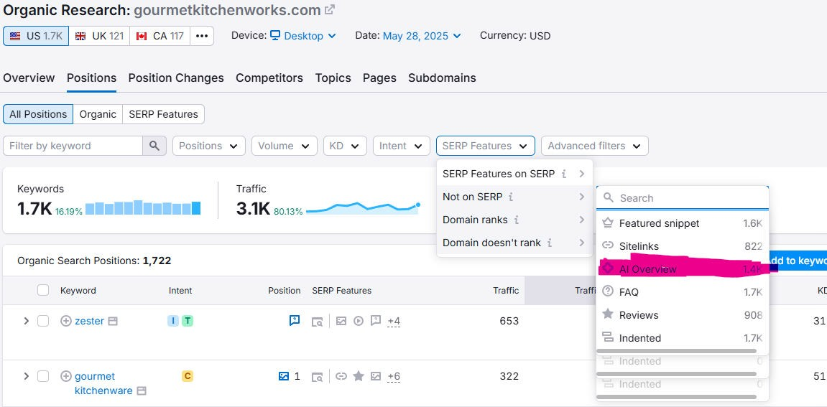

Slide 4
